Slide 1

Peer presentation
Ida & Elisa – Group 20
Picture is generated by ChatGPT
Notes:
Hello! We are Ida and Elisa and we are two analysts from the structural group, and we are both studying for our master’s degree in civil engineering here at DTU. Before attending this course, we had minimal experience with coding, python, and the IFC Standard so this project was both challenging and very educational for us.

Slide 2
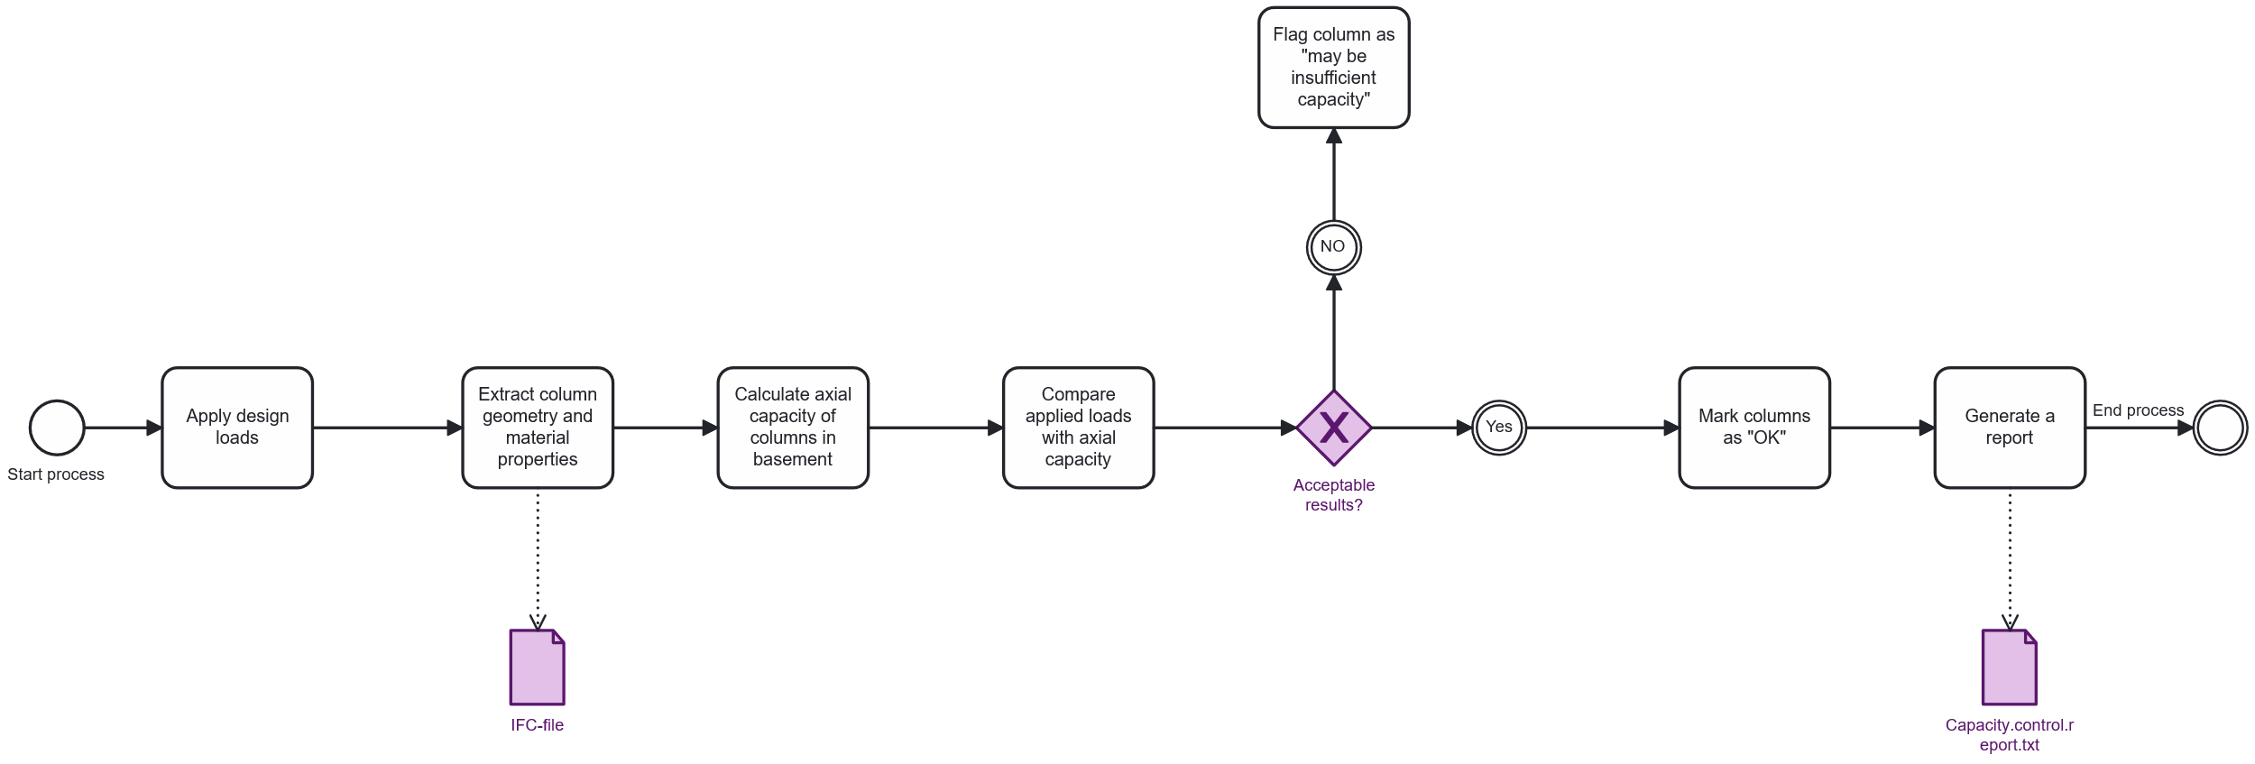
BPMN - tool
Notes:
The process starts by applying the design loads and extracting the columns geometry and material properties from the IFC model.
Based on this information, the tool calculates the axial capacity of the basement columns.
Then we compare the applied loads with the calculated capacity. If the results are not acceptable, the column is flagged as «may be insufficient». Is they’re acceptable, then it’s marked as OK.
Finally, the tool generates a capacity –control report summarizing all outcomes before the process ends.

Slide 3





Aim of our tool
Evaluates axial load capacity of IFC Columns
Uses material, geometry, and Global ID
Checks if Ned (design load) < Nrd (axial capacity)
Outputs a report: OK or maybe insufficient
Notes:
The aim of our tool is to evaluate the axial load capacity of the columns in an IFC model. The tool uses key information such as material properties, geometric dimensions, and the GlobalId of each column.
The applied load, Ned, is currently provided manually by the user. In our case, the value comes from an external load report. With further development, the script could be extended to calculate loads automatically by analyzing the loads applied to slabs and beams.
Based on these inputs, the tool generates a clear and simple report indicating whether each column satisfies the required capacity or if it may be insufficient.
In short, the tool provides a fast and consistent way to verify column capacity early in the design process, helping engineers identify potential issues before moving into more detailed calculations.

Slide 4
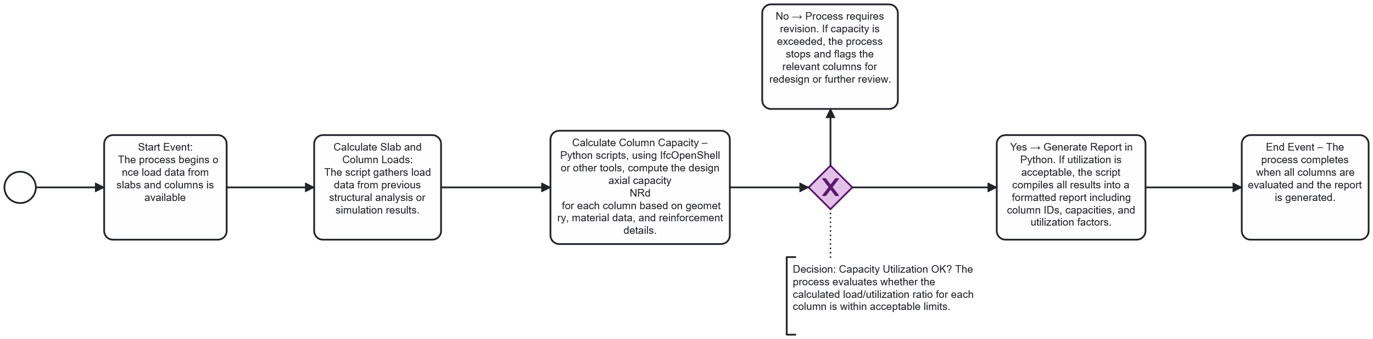
BPMN - workflow
Notes:
A more detailed workflow behind our tool.
During the process, we actually had to make one change. The original plan was to use load data from slabs and beams provided by another group, but during the process we switched to using the loads from the report from Advanced Building Design instead.
Next, we used the IFCOpenShell library to figure out how to extract all the information we needed to calculate the axial capacity for each column. We set up the script so that it can pull the relevant data depending on which storey you want to check. Since we focused on the basement, and all the columns there are concrete, we limited the material scope to concrete.
After that, we built the script that applies the loads to each column, computes the axial capacity, and then automatically generates a report with all the results directly into a folder. So the whole process, from reading the IFC-model to producing the final report, runs through the Python script.

Slide 5




Our tool
How to run the tool
1. Requirements:
🐍 Python
🧩 IfcOpenShell
2. Prepeare the IFC Model
- Save a structural model as an IFC file.
- Place it in the same folder as the script.
3. Run the script
Open the IFC file
- Apply the loads
- Run the code
4. Create a report with the results
“Capacity.control.report.txt” will be created automatically
Open report to see pass/fail status
Notes:
Now we’re going to explain how to run the tool.
1. First, there are two requirements. You need a program that can run Python code, and you need the IfcOpenShell library installed so that the script can extract data from the IFC file.
2. Second, you prepare your IFC model. You save your structural model as an IFC file and place it in the same folder as the script. If you want to keep the IFC file somewhere else, you simply update the MODEL_PATH at the top of the script.
3. Third, you run the script. The script will open the IFC file, apply the user-defined load, and automatically perform all the geometry extraction and capacity calculations.
4. Finally, you open the text report that is automatically generated. This report shows the pass/fail status for each column and includes all the important values such as dimensions, material strength, area, and Nrd.

Slide 6
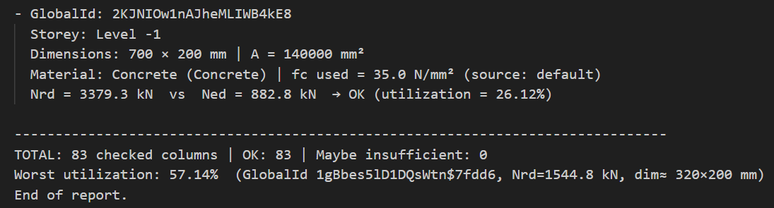
Output - "Capacity.control.report.txt"
Notes:
Here is an excerpt showing what the report looks like. It is sorted by the GlobalID of each column, making it easy to identify which column the calculations refer to. The report includes the storey where the column is located, its dimensions and material, the applied loads, the calculated capacity, the status check, and the utilization.
At the end, there is a summary showing how many columns were checked, how many passed, and how many did not. It also highlights the worst-case utilization and identifies which column it corresponds to.

